Slide 1
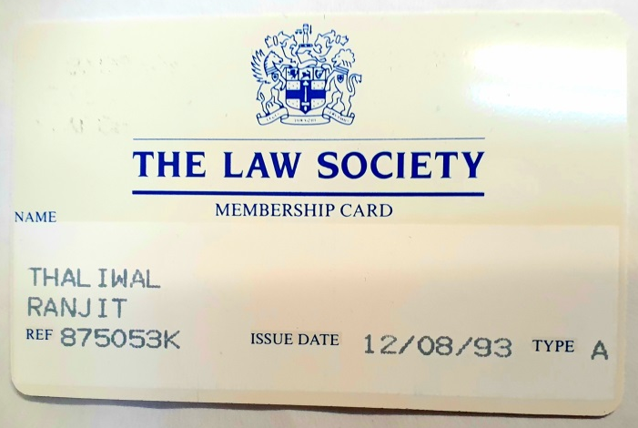
INTRODUCTION
Qualified some time ago…
Mental Health review work and representation across the spectrum. Forensic, non-forensic, NHS and Private units, Midlands wide coverage.
Office in Leicester and born in Leicester – a city of great diversity, hopefully adding to my knowledge and understanding of BAME issues.

Slide 2
PRESENTATION OVERVIEW
What effects those from the BAME community while detained.
Do those difficult experiences impact on general wellbeing and mental health.
Bringing those issues into the Tribunal arena.
Evidence based and experience based matters.

Slide 3
I AM SECTIONED AND REALLY ANNOYED ABOUT….
The language barrier – it causes difficulties including misinterpretation, isolation, difficulties in engaging in social activities and hinders the assessment process.
Section 17 leave being cancelled last minute – often due to unexpected circumstances, prevents important tasks being completed, it heightens frustration, can lead to an incident and basic essentials can be left unresolved.
Cultural/religious matters – access to a place of worship, key religious dates, food, social activities and visitation policy.
Not having culturally appropriate advocacy.

Slide 4
STATISTICS AND DISCUSSION

Slide 5
STATISTICS AND DISCUSSION

Slide 6
STATISTICS AND DISCUSSION

Slide 7
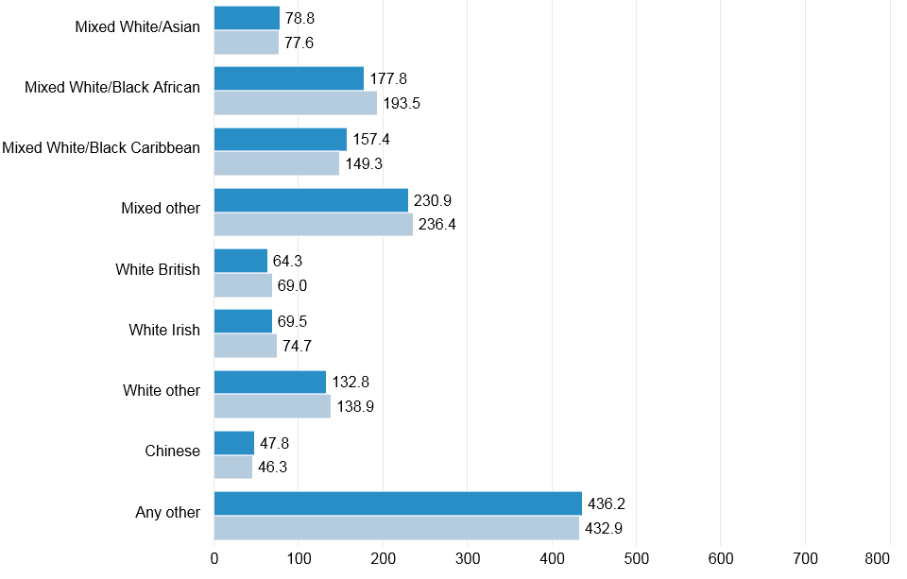
STATISTICS AND DISCUSSION

Slide 8
DISCUSSION
Quite significant differences exist:
The reasons behind this need exploration. (Source: government.uk. Published March 2019).
What are the possible reasons……….

Slide 9
DISCUSSION
The possible reasons……….
More voluntary admissions rather than by compulsion.
Making mental health staff more aware of problems faced by non-white patients and then seek to address them.
Misinterpretation – Steven Gilbert independent article (5th December 2018).
He was sectioned at the age of 26 after an episode and said “I have got a really loud voice but that can be misinterpreted as me being aggressive. My voice gets a bit loud when I am scared or anxious.”

Slide 10
WHY ARE THERE MORE DETENTIONS FROM THE BAME COMMUNITY
The stigma or shame attributed to mental health help or detention.
Huge differences between the BAME strata figures, e.g. the Bangladeshi community amongst Asians remains a spike figure.
Black African and Black Caribbean remain significant figures in comparison with the average statistics.
The ‘other’ category can be skewed, due to it being used as a catch all category.

Slide 11
HOW COULD IT BE IMPROVED?
Better information regarding mental health literacy and practical support, in relation to mental health conditions and to combat stigma.
Clarity regarding mental health services and access pathways.
A focus on tailored and culturally sensitive care.
Better engagement with the BAME community regarding the delivery of services.

Slide 12
QUOTATIONS FROM BAME CLIENTS
AB – “I am of West Indian origin and often speak Patois to my family members, including when I call back home. On occasion, when I have spoken Patois on the ward this has been interpreted as a relapse signature against me, which I thought was somewhat unfair, as I speak Patois out of my own free choice.”
“The other issue is that sometimes language can get misconstrued, as when words are expressed to me by the team I don’t always understand the meaning of them.”

Slide 13
BAME – THE HOME DYNAMIC AND IMPLICATIONS FOR ADMISSION
Regarding those detained for the first time, there may be an impact in terms of the home dynamic and their presentation at point of impact. This is a general point and clearly not a catch all.
The extended family situation, for example, within the Asian culture, may mean that the commencement of mental health problems are contained within the home environment. The implication is that they may then get to a pressure valve emergency stage, by the time admission arises.

Slide 14
CONCLUDING NOTE
The ward experience for those from a BAME background can be different, thus impacting upon their behaviour.
The risk includes major misinterpretation, which could have an impact on treatment, diagnosis and progression.
Not every client has an extensive support mechanism and this can contribute to isolation.
Statistics are statistics but trends are visible.
In a tribunal context, expressing frustrations can be very beneficial, irrespective of the outcome of the Tribunal hearing.

